Slide 1
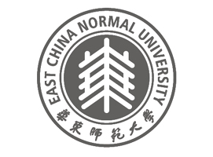
Education in China:
Characteristics and Problems
Mei Li
limeiwang@yaoo.com
Institute of Higher Education,
East China Normal University
Oct. 1, 2013
@ University of Ljubljana

Slide 2
Outline
System and management
Development and investment
Basic education
Comparison: Pisa, Confucian-heritage-cultures
Problems
Conclusions

Slide 3
Contexts:
Major Challenges face China
Largest developing country
Largest population
Limited resources
Inequality and disparity: Huge gap between rural and urban areas
Economic transformation
Corruption, political reforms
Environmental problems
…….

Slide 4
World Bank development indicator China: 2011
Total population | 1 344 130 000
Population of 15-64(%) | 72%
Population in education system | 0.26 Billion
Life expectancy at birth | 73
GDP Growth | 9.0%
GDP Per capital (2010) | $ 4,260
GDP | $7 298 096 609 544
Inflation | 7.6%

Slide 5
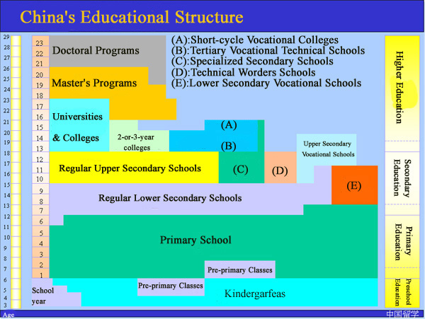

Slide 6
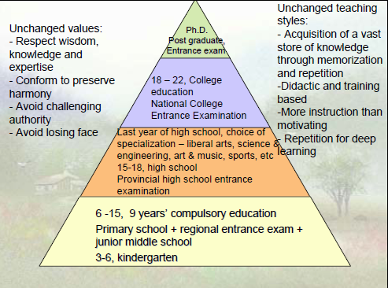

Slide 7
Administrative systems
Administrative systems at four levels from central to local
National: Ministry of Education
Provincial/municipal: Education commission
City/Region: Bureau of education
County/district: Department of education

Slide 8
Laws of education
“Compulsory Education Law” Issued in 1986, Modified in 2006
“Teacher Education Law ” Issued in 1993
“Education Law ” Issued in 1995
“Vocational Education Law ” Issued in 1996
“Higher Education Law ” Issued in 1998
“Law on the Promotion of Private Education” Issued in 2002

Slide 9
Driving forces of fast educational development
Legal system: Laws and Regulations
Stable political environment
Fast and substantial socio-economic development
Demographic change, One-child of family planning policy
High expectation and value of education
Certification and degree demand for employment with Industrial reconstruction
Urbanization
Increasing investment through multiple sources: government, individual, NGO, private agencies, etc.

Slide 10
Demographic changes of age-cohort in primary, junior secondary, senior secondary, and tertiary education
（2004-2020年）
In ten thousand

Slide 11
Gross enrolment rate by level: 1996-2005

Slide 12
Increasing number of private schools

Slide 13
Educational Development indicators in China (MOE: Medium and long-term national planning)
Indicator | 2009 | 2015 | 2020
Three-year pre-school gross enrolment rate(%) | 50.9 | 60.0 | 70.0
Nine-year compulsory education GER(%) | 90.8 | 93.0 | 95.0
Senior secondary school GER (%) | 79.2 | 87.0 | 90.0
Higher education GER (%) | 24.2 | 36.0 | 40.0

Slide 14
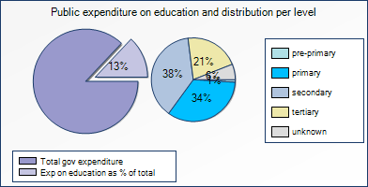
Public expenditure on education: 2004

Slide 15
Governmental investment in education:1994-2003
 | 1994 | 2003 | 2003/1994
Total investment（billion yuan） (%) | 148.9 (100) | 620.8 (100) | 4.2
Of which: governmental allocation （billion yuan） （%） | 117.5 (78.9) | 391.1 (63.0) | 3.3
Of which: private & social sources（billion yuan）（%） | 31.4 (21.1) | 229.7 (37.0) | 7.3

Slide 16
Governmental allocation of fund per student by level
Unit：Yuan in RMB
Year | 2000 | 2004 | 2004/2000
Tertiary education | 7,310 | 5,552 | 76%
Senior secondary | 1,315 | 1,759 | 134%
Junior secondary | 680 | 1,246 | 183%
Primary education | 492 | 1,129 | 229%

Slide 17
Cost-sharing:
Tuition fees’ contribution to educational investment:1994-2003 (%)
Year/level | Regular higher institution | Specialized secondary school | Senior secondary school
1994 | 10.4 | 20.9 | 10.8
2000 | 21.1 | 33.5 | 18.1
2003 | 28.8 | 33.1 | 21.7
% change of 2003 compared to 1994 | 18.4 | 12.2 | 10.9

Slide 18
No of schools and students at different levels: 2010
Level | No. of school (Thousand) | No. of students (Thousand) | Average No. of student per school | Gross enrollment rate
Primary education | 257.4 | 99 407 | 386 | 99.7%
Junior secondary | 54.9 | 52 793 | 962 | 100%
Senior Secondary | 28.584 | 46 773.4 | 1636 | 82.5%
Higher Education | 2.723 | 31 050 | 11402.9 | 26.5%

Slide 19
Student-teacher ratio: 2010
Level | Student-teacher ratio
Primary school | 17.7:1
General junior secondary school | 15.0:1
General senior secondary school | 16.0:1
Vocational secondary school | 26.4:1

Slide 20
Basic education
Basic education includes primary education and regular secondary education
Local governments responsible for basic education
Nine-Year Compulsory Education (NYCE) had been universalized in the area where 90% of the population inhabits

Slide 21
School arrangements
Industrial production: mass production
Subject: teaching by divided subject areas
3 major subjects: Math, Chinese, English: 3+X
Fixed class and classroom according to student’s age
Examination-oriented

Slide 22
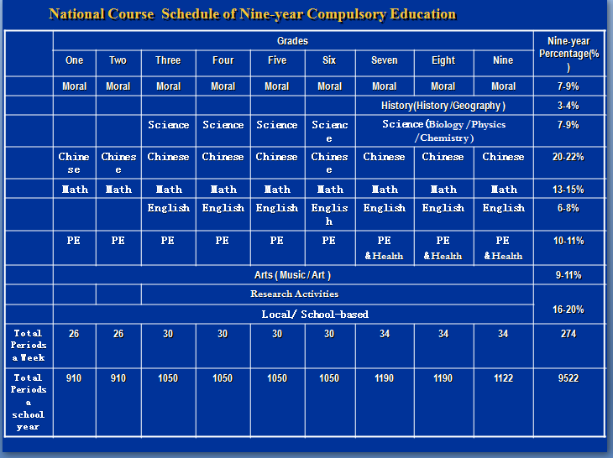

Slide 23
Class size
In 2010:
Nationwide, the average number of students per class for primary school is 38, for general junior secondary school is 53, for general senior secondary school is 57.
The percentage of the big size class (>56) for primary school accounts for 14%.Which for junior secondary school is 36.6%, for senior sec. is 51.2%

Slide 24
The Dropout Rate of Primary Education(2000-2006)
%

Slide 25
Gender Parity

Slide 26
Comparison: PISA and achievement of CHC students
Confucian-heritage-cultures (CHC): Mainland China, Taiwan, HK, Macau, Singapore, Japan, and Korea (Ho 1991)
Typically, CHC classes are large, in excess of 40 and over, and appear to western observers as highly authoritarian: teaching methods are mostly expository, sharply focused on preparation for external examinations (Biggs 1991).
Exams themselves address low-level cognitive goals, are highly competitive, and exert excessive pressure on teachers and exam stress on students.

Slide 27
OECD Programme for international assessment(PISA)
PISA is an international study that was launched by the OECD in 1997. It aims to evaluate education systems worldwide every three years by assessing 15-year-olds' competencies in the key subjects: reading, mathematics and science.
To date over 70 countries and economies have participated in PISA.

Slide 28
2009 Pisa
 | reading scale | math scale | science scale
OECD Average | 493 | 496 | 501
Shanghai-China | 556 | 600 | 575
South Korea | 539 | 546 | 538
Finland | 536 | 541 | 554
HK-China | 533 | 555 | 549
Singapore | 526 | 562 | 542
Canada | 524 | 527 | 529
New Zealand | 521 | 519 | 532
Japan | 520 | 529 | 539
Australia | 515 | 514 | 527
The United States | 500 | 487 | 502

Slide 29
Good learning environments
(Biggs and Moore 1993)
Teaching methods are varied, emphasizing student activity, self-regulation and student-centredness, with much cooperative and other group work
Content is presented in a meaningful context
Small classes
Warm classroom climate
High cognitive level outcomes are expected and addresses in assessment
Assessment is classroom-based and conducted in nonthreatening atmosphere

Slide 30
Performance of CHC students
A challenge to western research: Chinese learners’ paradox: assumption
CHC Classroom should be conducive to low quality outcomes: rote learning and low achievement
CHC students are perceived as using low-level, rote-bases strategies
In real situation:
CHC students have significantly higher levels of achievement than those of Western students
CHC students report a preference for high-level, meaning-based learning strategies

Slide 31
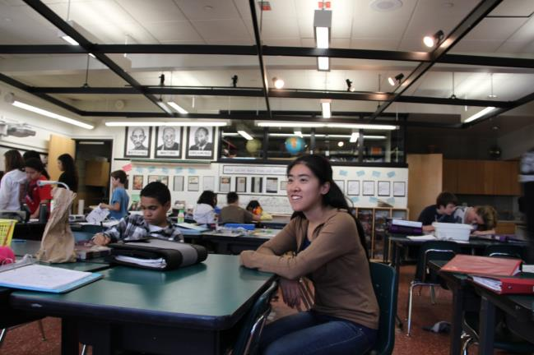
Classroom at UCLA lab school

Slide 32
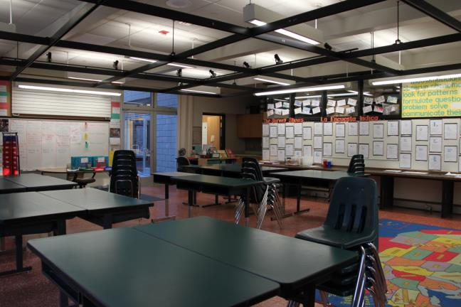
Classroom in UCLA lab school

Slide 33
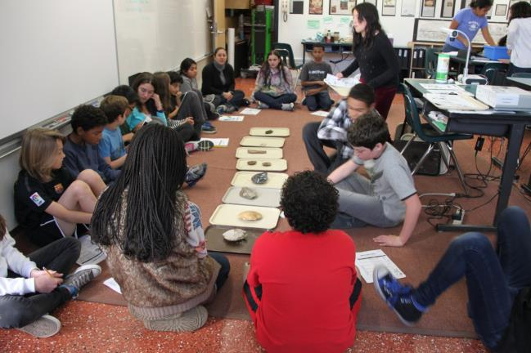
Learning activities at UCLA lab school

Slide 34
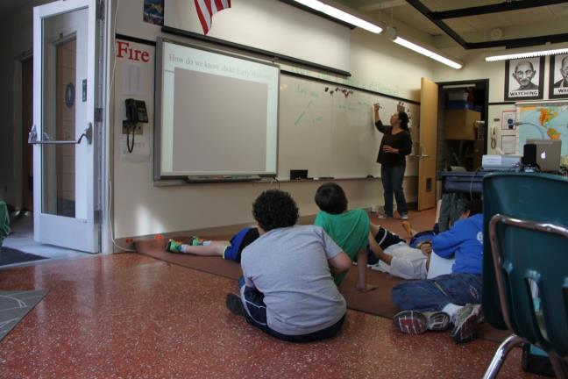
Learning activities at UCLA lab school

Slide 35
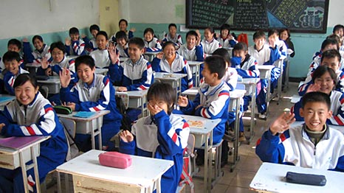
A Classroom in China

Slide 36
Comparison
Teaching and learning in China
Teaching and learning in the US
Large class size
Teacher-student relationship: authority-hierarchy
Knowledge and skills transferring
More teacher and subject-centered
Small class size
Teacher-student relationship: equal
Knowledge creativity
More content and student-centered

Slide 37
Q1: How do you understand the teaching and learning in the Confucian-Heritage Cultural contexts?
Q2: Why Confucian-Heritage Cultural students outperformed their western peers in Pisa?

Slide 38
Possible reasons
Chinese believe in diligence, Hard work-practice makes perfect
Family/parents’ involvement in Children's education and high expectation and investment
Confucian culture of respect education and scholarship
School arrangements for professional development of teachers, such as “teaching study group”

Slide 39
School life in China
School day
Timetable

Slide 40
Timetable of Grade 8 in Shanghai Jincai Experimental secondary school
Morning 8:30am
Mon Tues Wedn Thur Friday
Math English Chinese Math Chinese
English English Chinese Math Geography
Chinese Music English Chinese Math
PE Math Self-study PE English
Afternoon
History Chinese Math English History
Geography PE Science Politics Class meeting
Extension Arts Labor & skill Science
Extension Science PE Self-study

Slide 41
Long hours weekdays- hard work
Morning
Afternoon-Evening
6:30 Get up
7:00 breakfast
7:50-8:15 morning reading (flag rising ceremony on Mon.)
8:30-9:10 1st Period
9:20-10:00 2nd Period
10:00-10:20 body exercise
10:30-11:10 3rd period
11:20-12:00 4th period
12:00-1:20PM lunch, nap
1:30-2:10 5th Period
2:20-3:00 6th Period
3:10-3:50 7th Period
4:00-4:40 8th Period
6:00 Dinner, Watch TV
7:00-9:30 Homework
10:00 go to bed

Slide 42
Problems and challenges in China
A Disparity and inequity
B School Choice
C Examination and heavy burden

Slide 43
A Disparity and uneven development
Common issues of developing countries
Disparity between rural and urban areas
Disparity between regions (western and eastern region)
Disparity between good (key school) and average, poor school
Priority of 11TH 5 year plan: developing the western region

Slide 44
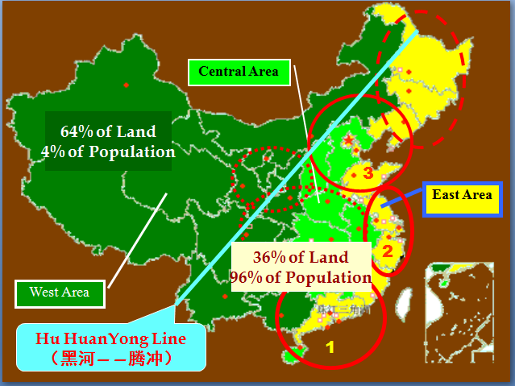
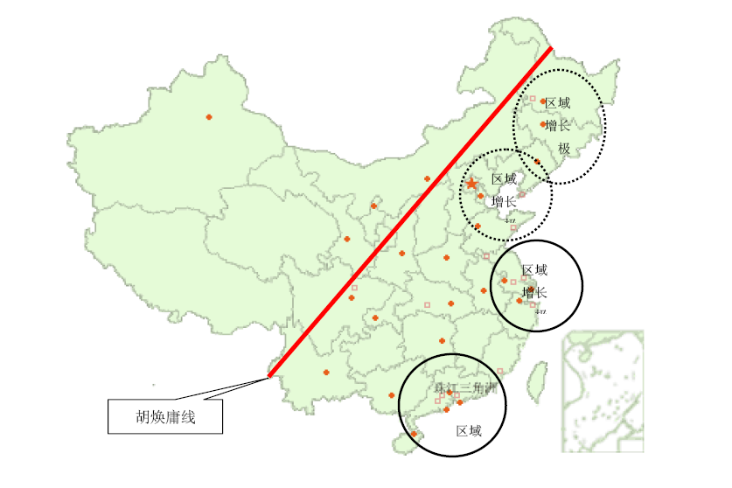
Disparity: eastern and western regions

Slide 45
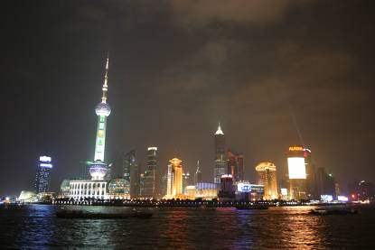
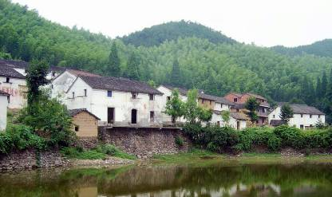
International metropolitans like Beijing and Shanghai
As a developing country, the urban-rural divide in China.
In Vast rural areas, agriculture

Slide 46
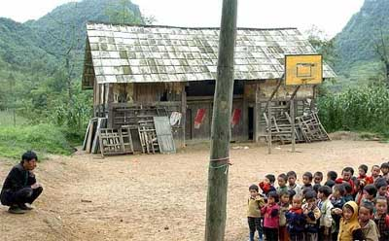
A teaching site in the remote rural area in the past

Slide 47
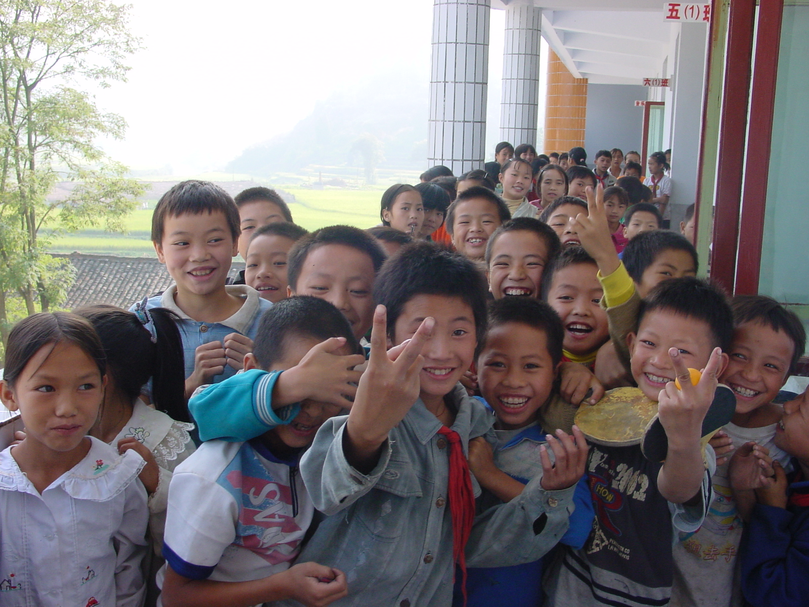
After lesson in Guizhou

Slide 48
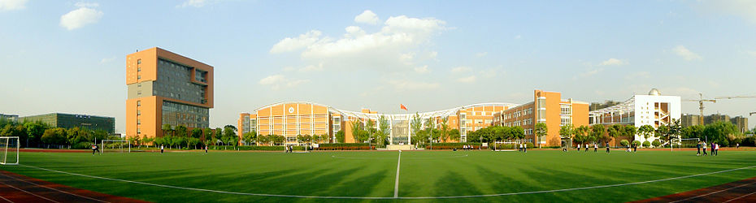
One of the best schools in Shanghai:
No. 2 Affiliated High School of ECNU

Slide 49
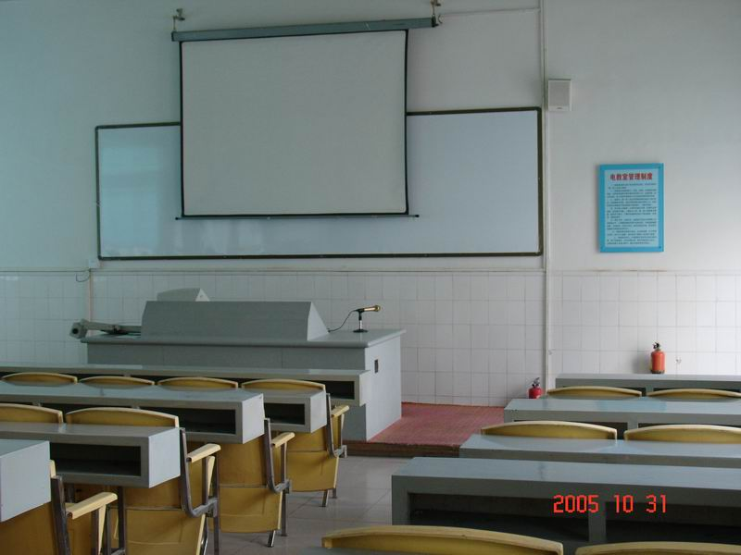
A classroom in an urban school

Slide 50
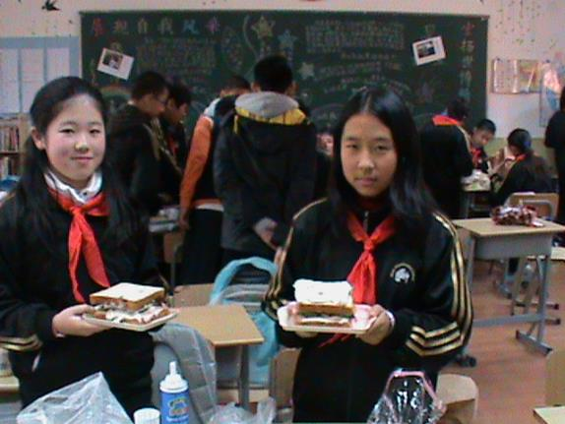
Classroom activity

Slide 51
B school choice
Huge gap of quality and resources, condition between key school and average school
Residence system (huji zhi)
Migration/mobility for choosing good school, within city, between cities
Sponsorship-fee
Catch areas admission for primary school
Abolition of key school in compulsory education, yet key school in senior secondary

Slide 52
C examination hell
In Mainland China, education in general and basic education in particular, is an exam-oriented system.

Slide 53
Why China’s education system is exam-oriented?
Group work: pair student discussion
Q 1: In which countries/societies, their education systems are exam-oriented?
Q 2: Why Confucian-heritage-cultural education systems are exam-oriented?
Reasons
Examples

Slide 54
Imperial Civil Service Exam
Lasted for 1300 years, from Sui Dynasty to Late Qing Dynasty(605-1905)
The Emperor Tang Taizong claimed, “with ICSE, all talent people under my regime/control”
Far-reaching impacts politically, socially and psychologically in Pre-modern China and modern China
Influence other countries as well, British civil service system, Vietnam had adopted Imperial Civil Service Exam (1807-1919), Yi Dynasty in Korea (1310-1910)

Slide 55
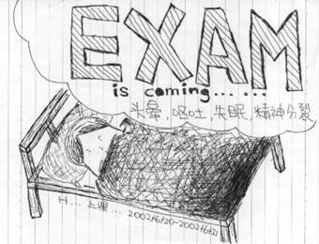
Negative Effects: dizzy, vomiting, insomnia, schizophrenia

Slide 56
Conclusions
Rationales Society and education structure
Inclusive
Open access
Equity
Right
Mass/universal
Even quality and resources
Opportunity, process, outcome equity
Quality education, capability
Exclusive
Selective access
Hierarchy
Status, privilege, selection machine
Elite
Differentiated quality and resources
Selection, competition
Exam-oriented, knowledge

Slide 57
Strategies for improvement
Reduction of the disparities between rural and urban areas
Increasing investment by central governments: free compulsory education policy implemented since 2008
Faculty development
Enhancing education quality in rural areas
Curriculum reforms: constructive learning

Slide 58
Comments and Questions

